Slide 1
Personalization & Recommender Systems
Bamshad Mobasher
Center for Web Intelligence
DePaul University, Chicago, Illinois, USA

Slide 2
Predictive User Modeling for Personalization
The Problem
Dynamically serve customized content (ads, products, deals, recommendations, etc.) to users based on their profiles, preferences, or expected needs
Example: Recommender systems
Personalized information filtering systems that present items (films, television, video, music, books, news, restaurants, images, web pages, etc.) that are likely to be of interest to a given user

Slide 3
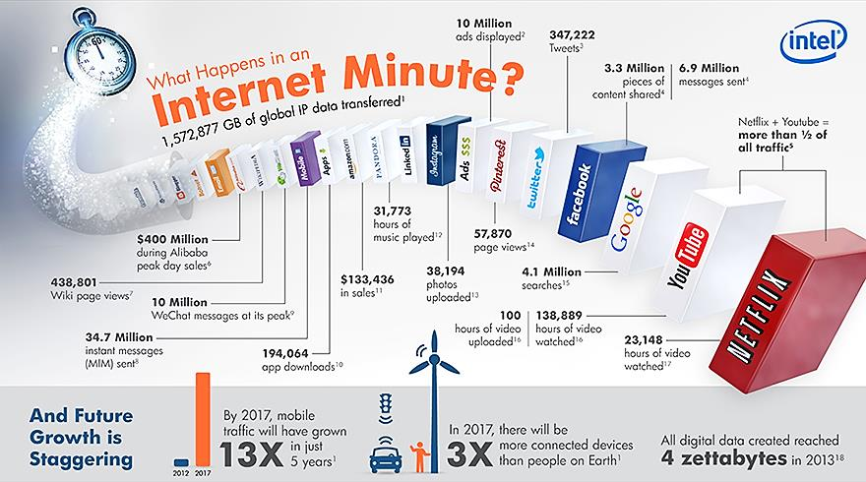
Why we need it?
Information spaces are becoming more complex for user to navigate (video/audio streaming, social networks, blogs, ….)

Slide 4
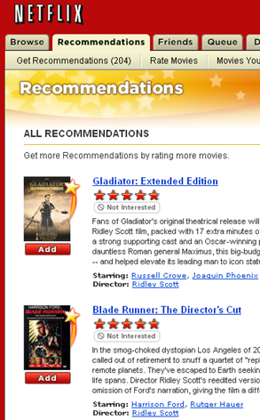
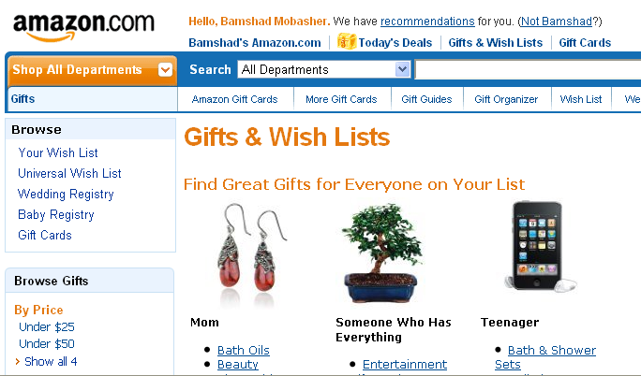
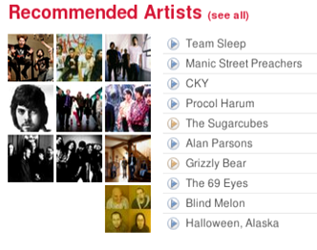
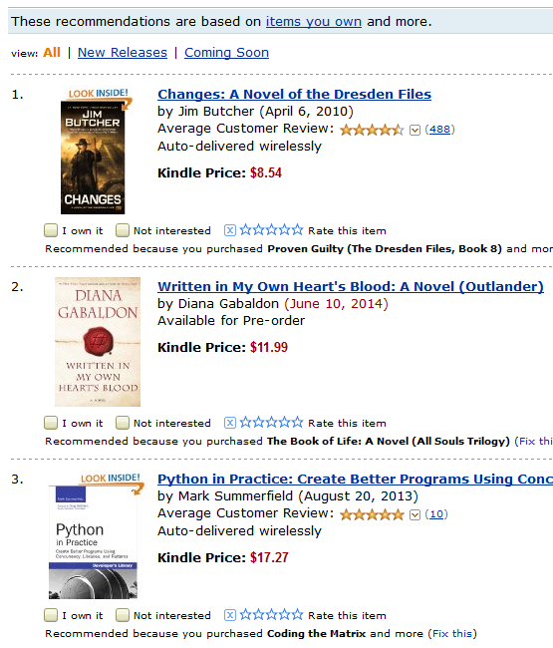
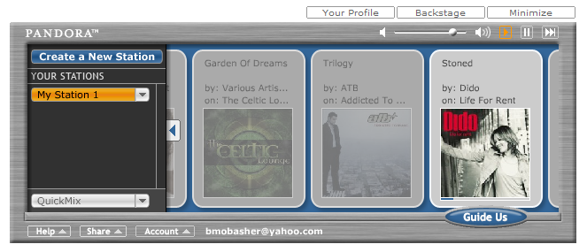
Why we need it?
For businesses: grow customer loyalty / increase sales
Amazon → 35% of sales from recommendation; increasing fast!
Netflix → 40%+ of movie selections from recommendation
Facebook → 90% of user interactions via personalized feeds

Slide 5
Common Approaches
Collaborative Filtering
Give recommendations to a user based on preferences of “similar” users
Preferences on items may be explicit or implicit
Includes recommendation based on social / collaborative content
Content-Based Filtering
Give recommendations to a user based on items with “similar” content in the user’s profile
Rule-Based (Knowledge-Based) Filtering
Provide recommendations to users based on predefined (or learned) rules
age(x, 25-35) and income(x, 70-100K) and childred(x, >=3) → recommend(x, Minivan)
Hybrid Approaches

Slide 6
The Recommendation Task
Basic formulation as a prediction problem
Typically, the profile P_{u} contains preference scores by u on some other items, {i₁, …, i_{k}} different from i_{t}
preference scores on i₁, …, i_{k} may have been obtained explicitly (e.g., movie ratings) or implicitly (e.g., time spent on a product page or a news article)
Given a profile P_{u} for a user u, and a target item i_{t}, predict the preference score of user u on item i_{t}

Slide 7
Recommendation as Rating Prediction
Two types of entities: Users and Items
Utility of item i for user u is represented by some rating r (where r ∈ Rating)
Each user typically rates a subset of items
Recommender system then tries to estimate/predict the unknown ratings, i.e., to extrapolate rating function Rec based on the known ratings:
Rec: Users × Items → Rating
i.e., two-dimensional recommendation framework
The recommendations to each user are made by offering his/her highest-rated items

Slide 8
Collaborative Recommender Systems
Collaborative filtering recommenders
Predictions for unseen (target) items are computed based the other users’ with similar interest scores on items in user u’s profile
i.e. users with similar tastes (aka “nearest neighbors”)
requires computing correlations between user u and other users according to interest scores or ratings
k-nearest-neighbor (knn) strategy
Can we predict Karen’s rating on the unseen item Independence Day?

Slide 9
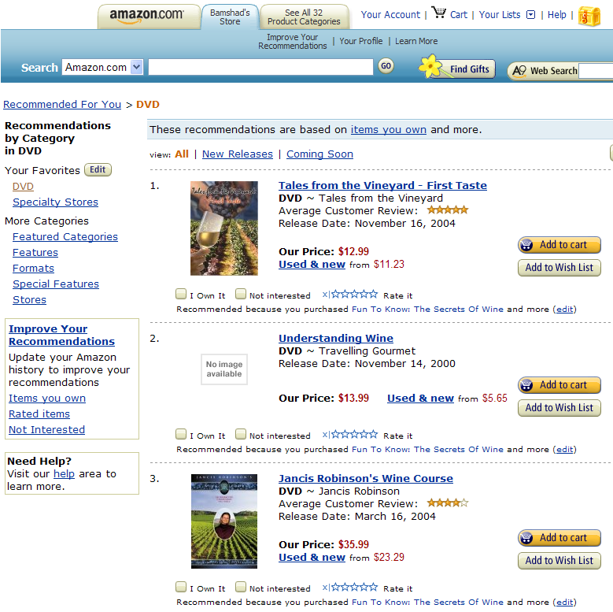
Collaborative Recommender Systems

Slide 10
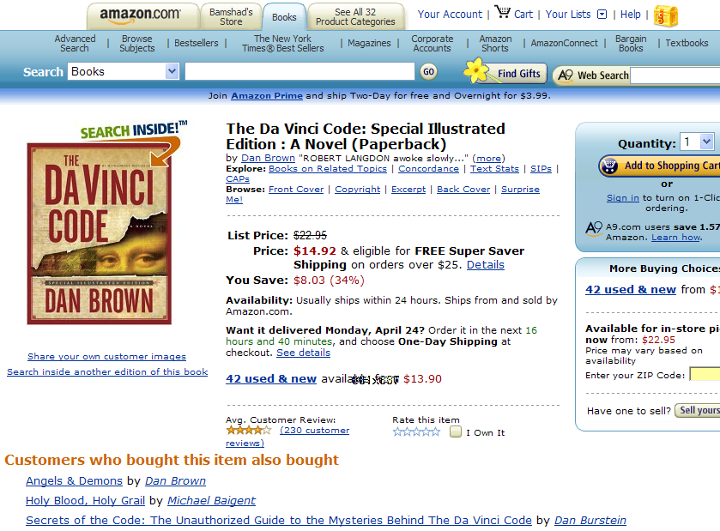
Collaborative Recommender Systems

Slide 11

Collaborative Recommender Systems

Slide 12
Basic Collaborative Filtering Process
Current User Record
<user, item1, item2, …>
Neighborhood
Formation
Nearest
Neighbors
Recommendation
Engine
Combination
Function
Historical
User Records
user
item
rating
Recommendations
Neighborhood Formation Phase
Recommendation Phase

Slide 13
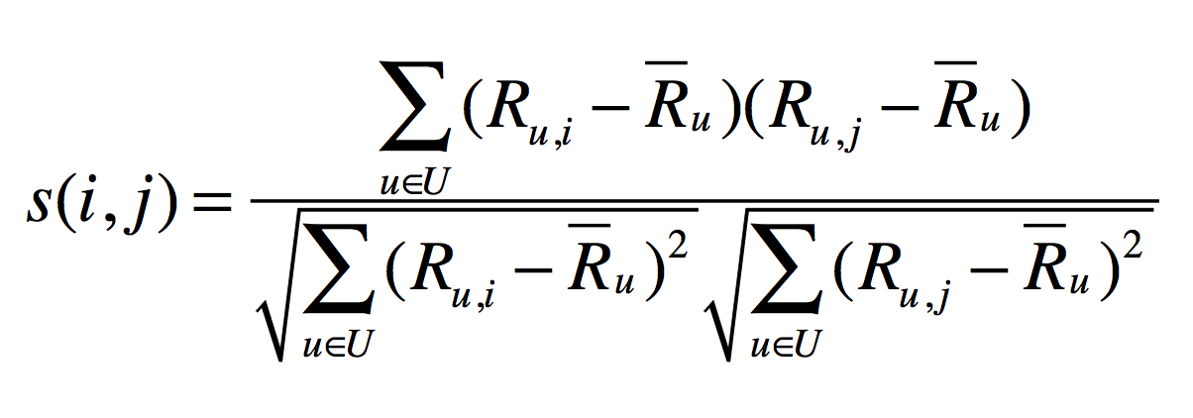
User-Based Collaborative Filtering
User-User Similarity: Pearson Correlation
Making Predictions: K-Nearest-Neighbor
R_{u} = mean rating for user u
R_{u,i} = rating of user u on item i
sim(i,j) = Pearson correlation between users i and j
P_{a,i} = predicted rating of user a on item I
R_{a} = mean rating for target user a
Sim(a,u) similarity (Pearson) between user a and neighbor u

Slide 14
Example Collaborative System
 | Item1 | Item 2 | Item 3 | Item 4 | Item 5 | Item 6 | Correlation with Alice
Alice | 5 | 2 | 3 | 3 |  | ?
User 1 | 2 |  | 4 |  | 4 | 1 | -1.00
User 2 | 2 | 1 | 3 |  | 1 | 2 | 0.33
User 3 | 4 | 2 | 3 | 2 |  | 1 | .90
User 4 | 3 | 3 | 2 |  | 3 | 1 | 0.19
User 5 |  | 3 |  | 2 | 2 | 2 | -1.00
User 6 | 5 | 3 |  | 1 | 3 | 2 | 0.65
User 7 |  | 5 |  | 1 | 5 | 1 | -1.00
Prediction

Best match
Using k-nearest neighbor with k = 1

Slide 15
Item-based Collaborative Filtering
Find similarities among the items based on ratings across users
Often measured based on a variation of Cosine measure
Prediction of item I for user a is based on the past ratings of user a on items similar to i.
Suppose:
Predicted rating for Karen on Indep. Day will be 7, because she rated Star Wars 7
That is if we only use the most similar item
Otherwise, we can use the k-most similar items and again use a weighted average
sim(Star Wars, Indep. Day) > sim(Jur. Park, Indep. Day) > sim(Termin., Indep. Day)

Slide 16
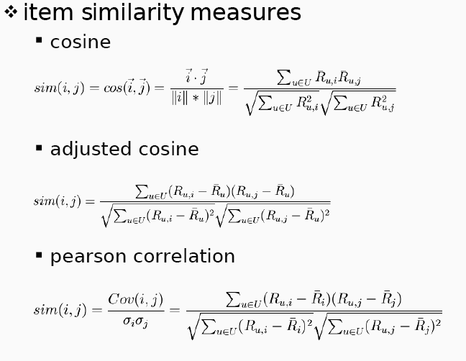
Item-based collaborative filtering

Slide 17
Item-Based Collaborative Filtering
Prediction

 | Item1 | Item 2 | Item 3 | Item 4 | Item 5 | Item 6
Alice | 5 | 2 | 3 | 3 |  | ?
User 1 | 2 |  | 4 |  | 4 | 1
User 2 | 2 | 1 | 3 |  | 1 | 2
User 3 | 4 | 2 | 3 | 2 |  | 1
User 4 | 3 | 3 | 2 |  | 3 | 1
User 5 |  | 3 |  | 2 | 2 | 2
User 6 | 5 | 3 |  | 1 | 3 | 2
User 7 |  | 5 |  | 1 | 5 | 1
Item similarity | 0.76 | 0.79 | 0.60 | 0.71 | 0.75
Best match

Slide 18
Collaborative Filtering: Evaluation
Split users into train/test sets
For each user a in the test set:
split a’s votes into observed (I) and to-predict (P)
measure average absolute deviation between predicted and actual votes in P
MAE = mean absolute error
Or RMSE = root mean squared error
average over all test users

Slide 19
Data sparsity problems
Cold start problem
How to recommend new items? What to recommend to new users?
Straightforward approaches
Ask/force users to rate a set of items
Use another method (e.g., content-based, demographic or simply non-personalized) in the initial phase
Alternatives
Use better algorithms (beyond nearest-neighbor approaches)
In nearest-neighbor approaches, the set of sufficiently similar neighbors might be too small to make good predictions
Use model-based approaches (clustering; dimensionality reduction, etc.)

Slide 20
Example algorithms for sparse datasets
Recursive CF
Assume there is a very close neighbor n of u who has not yet rated the target item i .
Apply CF-method recursively and predict a rating for item i for the neighbor
Use this predicted rating instead of the rating of a more distant direct neighbor
 | Item1 | Item2 | Item3 | Item4 | Item5
Alice | 5 | 3 | 4 | 4 | ?
User1 | 3 | 1 | 2 | 3 | ?
User2 | 4 | 3 | 4 | 3 | 5
User3 | 3 | 3 | 1 | 5 | 4
User4 | 1 | 5 | 5 | 2 | 1
sim = 0.85
Predict rating for
User1

Slide 21
More model-based approaches
Matrix factorization techniques, statistics
singular value decomposition, principal component analysis
Approaches based on clustering
Association rule mining
compare: shopping basket analysis
Probabilistic models
clustering models, Bayesian networks, probabilistic Latent Semantic Analysis
Various other machine learning approaches

Slide 22
Dimensionality Reduction
Basic idea: Trade more complex offline model building for faster online prediction generation
Singular Value Decomposition for dimensionality reduction of rating matrices
Captures important factors/aspects and their weights in the data
factors can be genre, actors but also non-understandable ones
Assumption that k dimensions capture the signals and filter out noise (K = 20 to 100)
Constant time to make recommendations
Approach also popular in information retrieval (Latent Semantic Indexing), data compression, …

Slide 23
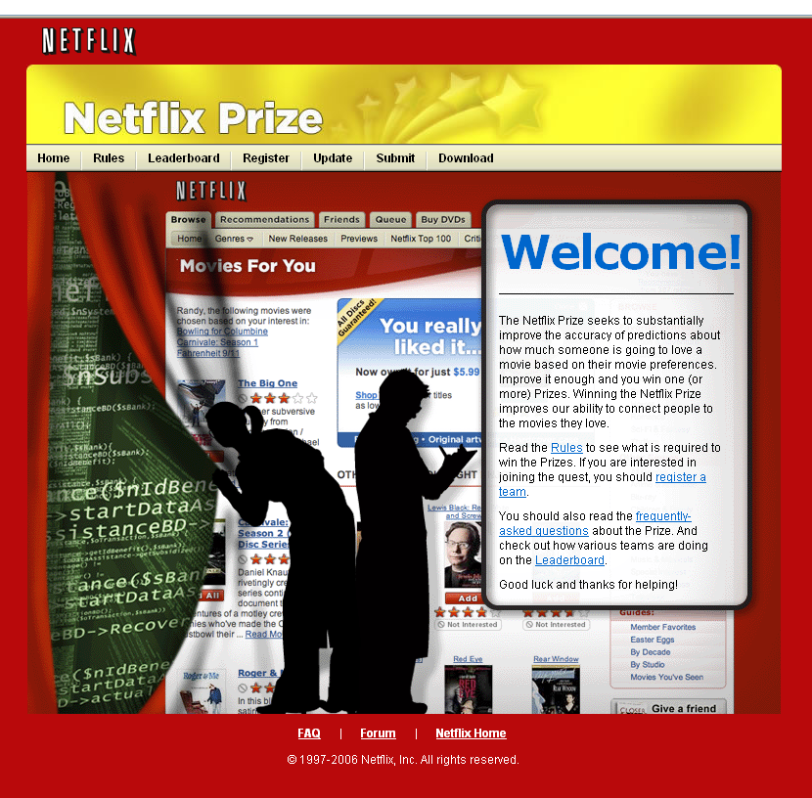
Netflix Prize & Matrix Factorization
17,700 movies
The $1 Million Question
1 | 3 | 4
 | 3 | 5 |  |  | 5
 |  | 4 | 5 |  | 5
 |  | 3
 |  | 3
2 |  |  | 2 |  | 2
 |  |  |  | 5
 | 2 | 1 |  |  | 1
 | 3 |  |  | 3
1
480,000
users

Slide 24
Matrix Factorization of Ratings Data
n movies
f
n movies
x
f
~
~
m users
m users
r_{ui} p_{u} q^{T}_{i}
~
~
Based on the idea of Latent Factor Analysis
Identify latent (unobserved) factors that “explain” observations in the data
In this case, observations are user ratings of movies
The factors may represent combinations of features or characteristics of movies and users that result in the ratings

Slide 25


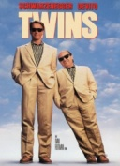


Matrix Factorization
P_{k} | Dim1 | Dim2
Alice | 0.47 | -0.30
Bob | -0.44 | 0.23
Mary | 0.70 | -0.06
Sue | 0.31 | 0.93
Q_{k}^{T}
Dim1 | -0.44 | -0.57 | 0.06 | 0.38 | 0.57
Dim2 | 0.58 | -0.66 | 0.26 | 0.18 | -0.36
Prediction:
Note: Can also do factorization via Singular Value Decomposition (SVD)
SVD:

Slide 26





Lower Dimensional Feature Space
Sue
Bob
Mary
Alice

Slide 27
Content-based recommendation
Collaborative filtering does NOT require any information about the items,
However, it might be reasonable to exploit such information
E.g. recommend fantasy novels to people who liked fantasy novels in the past
What do we need:
Some information about the available items such as the genre ("content")
Some sort of user profile describing what the user likes (the preferences)
The task:
Learn user preferences
Locate/recommend items that are "similar" to the user preferences

Slide 28






Content-Based Recommenders
Predictions for unseen (target) items are computed based on their similarity (in terms of content) to items in the user profile.
E.g., user profile P_{u} contains
recommend highly: and recommend “mildly”:

Slide 29
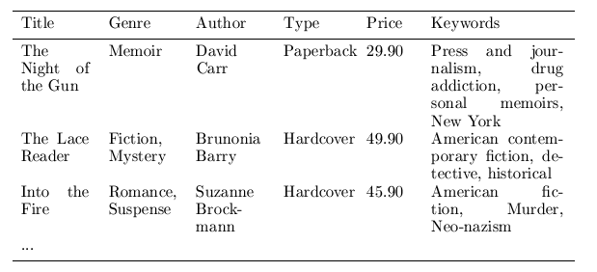
Content representation & item similarities
Represent items as vectors over features
Features may be items attributes, keywords, tags, etc.
Often items are represented a keyword vectors based on textual descriptions with TFxIDF or other weighting approaches
applicable to any type of item (images, products, news stories) as long as a textual description is available or can be constructed
Items (and users) can then be compared using standard vector space similarity measures (e.g., Cosine similarity)
Notes:
Intersection

Slide 30
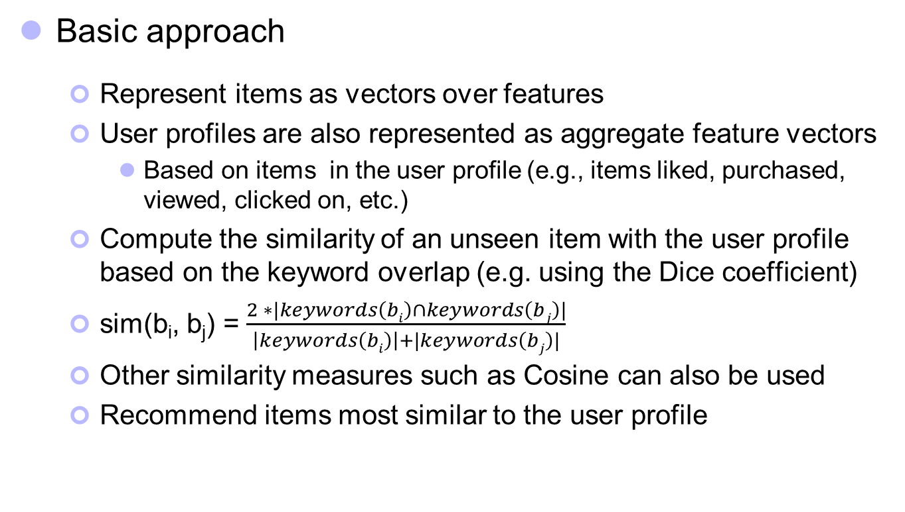
Content-based recommendation
Basic approach
Represent items as vectors over features
User profiles are also represented as aggregate feature vectors
Based on items in the user profile (e.g., items liked, purchased, viewed, clicked on, etc.)
Compute the similarity of an unseen item with the user profile based on the keyword overlap (e.g. using the Dice coefficient)
sim(b_{i}, b_{j}) = $\frac{2 ∗|keywords\left(bi\right)∩keywords\left(bj\right)|}{\left|keywords\left(bi\right)\right|+|keywords\left(bj\right)|}$
Other similarity measures such as Cosine can also be used
Recommend items most similar to the user profile
Notes:
Intersection

Slide 31
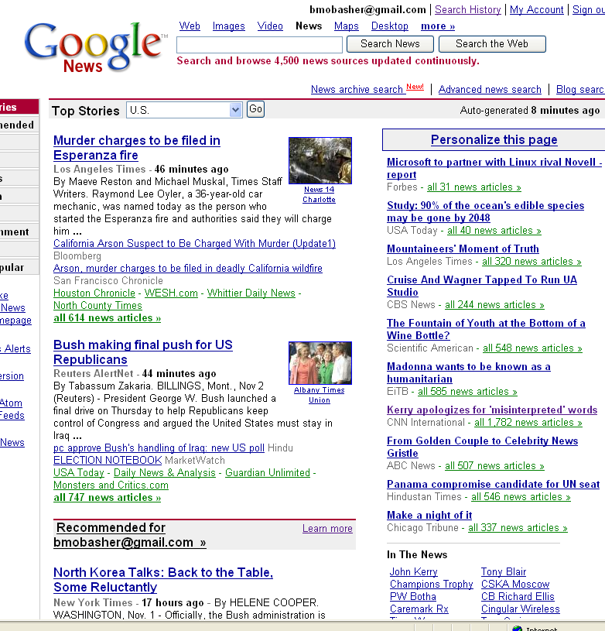
Content-Based Recommender Systems

Slide 32

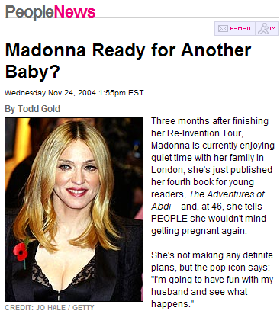
Content-Based Recommenders: Personalized Search
How can the search engine determine the “user’s intent”?
?
Query: “Madonna and Child”
?
Need to “learn” the user profile:
User is an art historian?
User is a pop music fan?

Slide 33
Content-Based Recommenders :: more examples
Music recommendations
Play list generation
Example: Pandora

Slide 34

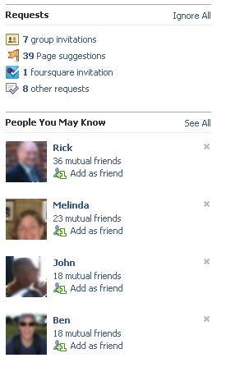
Social Recommendation
A form of collaborative filtering using social network data
Users profiles represented as sets of links to other nodes (users or items) in the network
Prediction problem: infer a currently non-existent link in the network

Slide 35
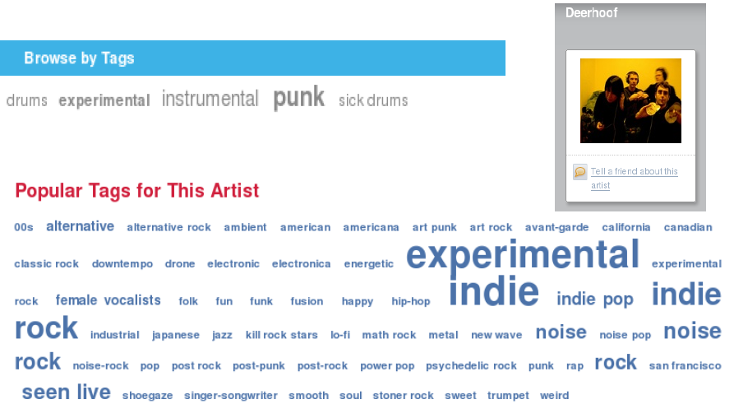
Social / Collaborative Tags

Slide 36
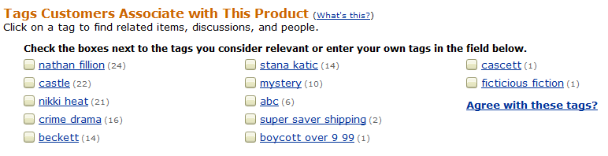

Example: Tags describe the Resource
Tags can describe
The resource (genre, actors, etc)
Organizational (toRead)
Subjective (awesome)
Ownership (abc)
etc

Slide 37
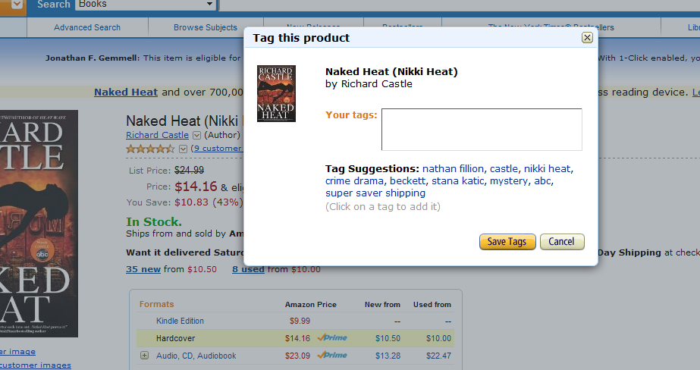
Tag Recommendation

Slide 38
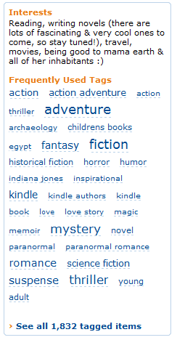


Tags describe the user
These systems are “collaborative.”
Recommendation / Analytics based on the “wisdom of crowds.”
Rai Aren's profile
co-author
“Secret of the Sands"

Slide 39
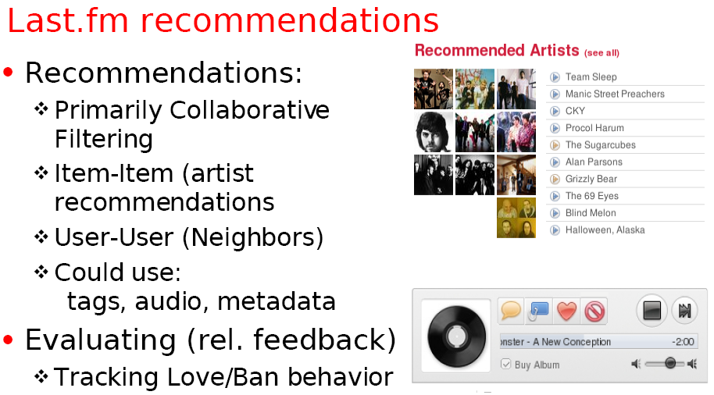
Example: Using Tags for Recommendation

Slide 40
Possible Interesting Project Ideas
Build a content-based recommender for
News stories (requires basic text processing and indexing of documents)
Blog posts, tweets
Music (based on features such as genre, artist, etc.)
Build a collaborative or social recommender
Movies (using movie ratings), e.g., movielens.org
Music, e.g., pandora.com, last.fm
Recommend songs or albums based on collaborative ratings, tags, etc.
recommend whole playlists based on playlists from other users
Recommend users (other raters, friends, followers, etc.), based similar interests

Slide 41
Combining Content-Based and Collaborative Recommendation
Example: Semantically Enhanced CF
Extend item-based collaborative filtering to incorporate both similarity based on ratings (or usage) as well as semantic similarity based on content / semantic information
Semantic knowledge about items
Can be extracted automatically from the Web based on domain-specific reference ontologies
Used in conjunction with user-item mappings to create a combined similarity measure for item comparisons
Singular value decomposition used to reduce noise in the content data
Semantic combination threshold
Used to determine the proportion of semantic and rating (or usage) similarities in the combined measure

Slide 42
Semantically Enhanced Hybrid Recommendation
An extension of the item-based algorithm
Use a combined similarity measure to compute item similarities:
where,
SemSim is the similarity of items i_{p} and i_{q} based on semantic features (e.g., keywords, attributes, etc.); and
RateSim is the similarity of items i_{p} and i_{q} based on user ratings (as in the standard item-based CF)
α is the semantic combination parameter:
α = 1 → only user ratings; no semantic similarity
α = 0 → only semantic features; no collaborative similarity

Slide 43
Semantically Enhanced CF
Movie data set
Movie ratings from the movielens data set
Semantic info. extracted from IMDB based on the following ontology

Slide 44
Semantically Enhanced CF
Used 10-fold x-validation on randomly selected test and training data sets
Each user in training set has at least 20 ratings (scale 1-5)

Slide 45
Semantically Enhanced CF
Dealing with new items and sparse data sets
For new items, select all movies with only one rating as the test data
Degrees of sparsity simulated using different ratios for training data

Slide 46
Data Mining Approach to Personalization
Basic Idea
generate aggregate user models (usage profiles) by discovering user access patterns through Web usage mining (offline process)
Clustering user transactions
Clustering items
Association rule mining
Sequential pattern discovery
match a user’s profile against the discovered models to provide dynamic content (online process)
Advantages
Can be applied to different types of user data (ratings, pageviews, items purchased, etc.)
Helps enhance the scalability of collaborative filtering

Slide 47
Conceptual Representation of User Profile Data
Items
User Profiles

Slide 48
Example: Using Clusters for Web Personalization
User navigation sessions
Given an active session A ➔ B, the best matching profile is Profile 1. This may result in a recommendation for page F.html, since it appears with high weight in that profile.
Result of
Clustering
PROFILE 0 (Cluster Size = 3)
--------------------------------------
1.00 C.html
1.00 D.html
PROFILE 1 (Cluster Size = 4)
--------------------------------------
1.00 B.html
1.00 F.html
0.75 A.html
0.25 C.html
PROFILE 2 (Cluster Size = 3)
--------------------------------------
1.00 A.html
1.00 D.html
1.00 E.html
0.33 C.html

Slide 49
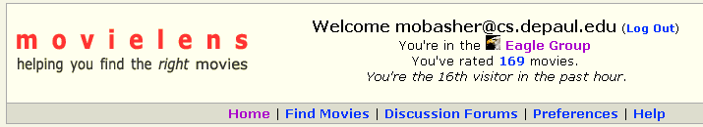
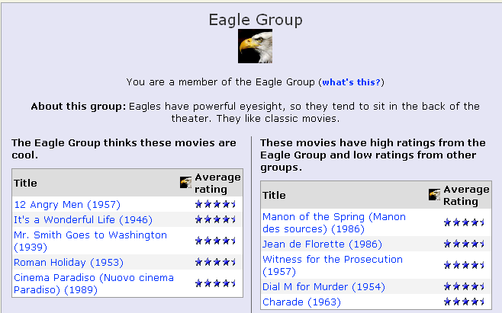
Clustering and Collaborative Filtering :: clustering based on ratings: movielens

Slide 50
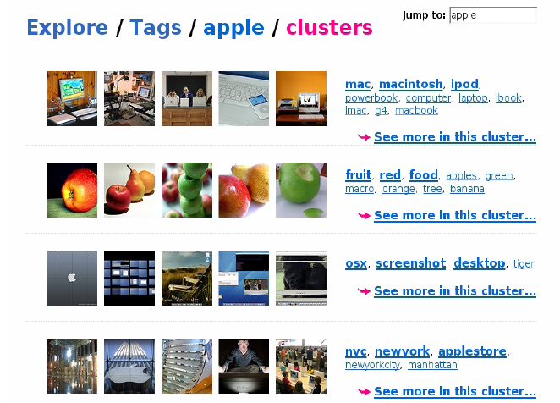
Clustering and Collaborative Filtering :: tag clustering example

